Slide 1
Projects Snaps

Slide 2
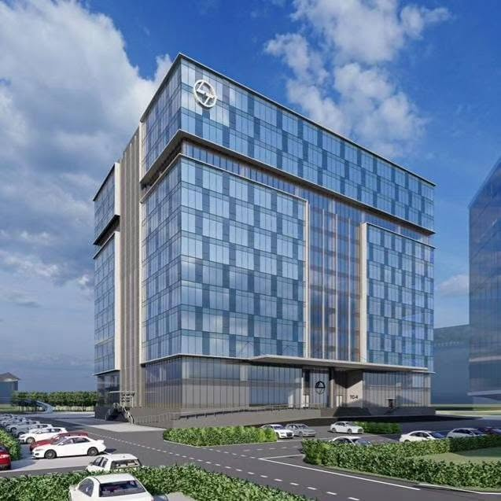
L&T TC4 Building Chennai
A 13-storey structure with 667,417 sqm built-up area

Slide 3


Anaplan office - Gurugram

Slide 4
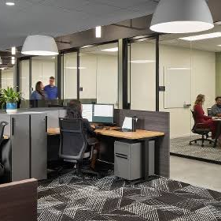
Trimont Hyderabad

Slide 5
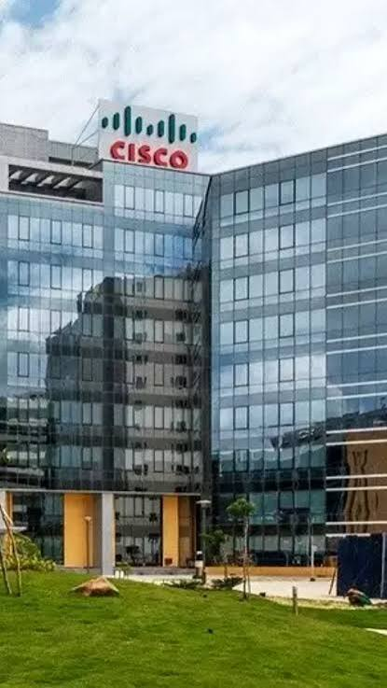
CISCO Bangalore
Building 11, 14, 15 & CISCO Hyderabad & Pune

Slide 6
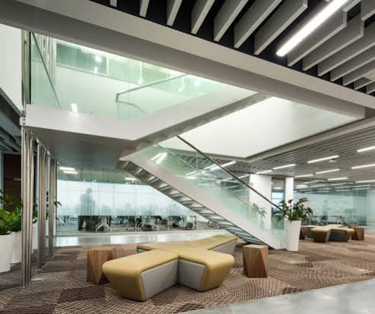
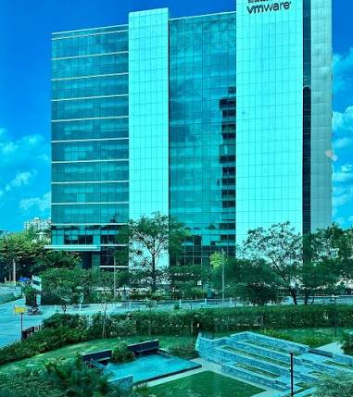
VM Ware Bangalore

Slide 7
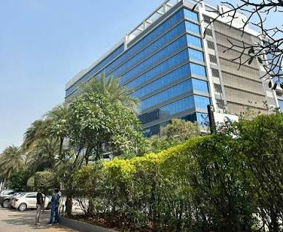

Johnson & Johnson Hyderabad

Slide 8
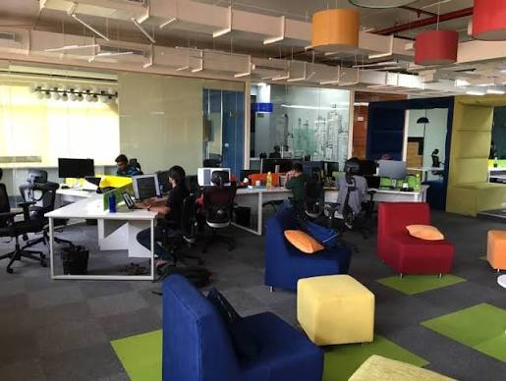
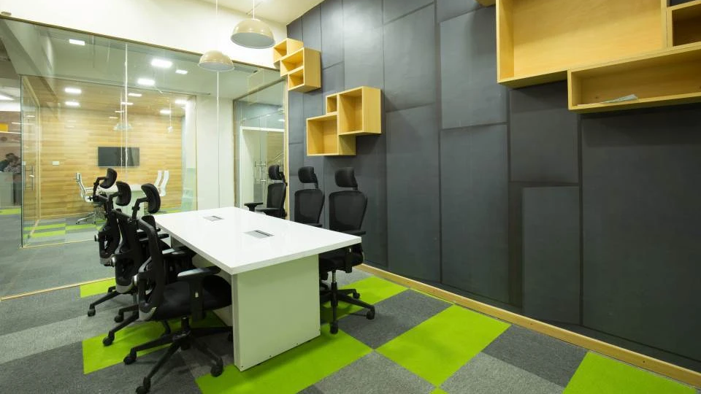
Razon Pay

Slide 9
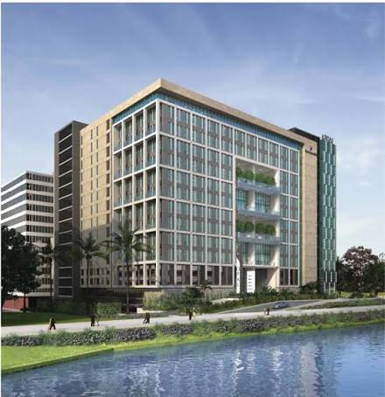
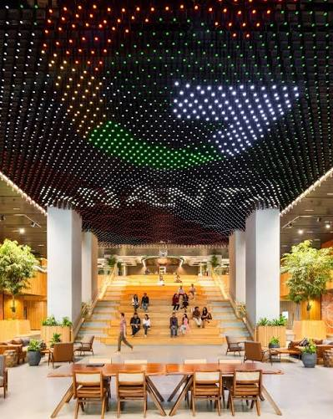
Google Opel

Slide 10
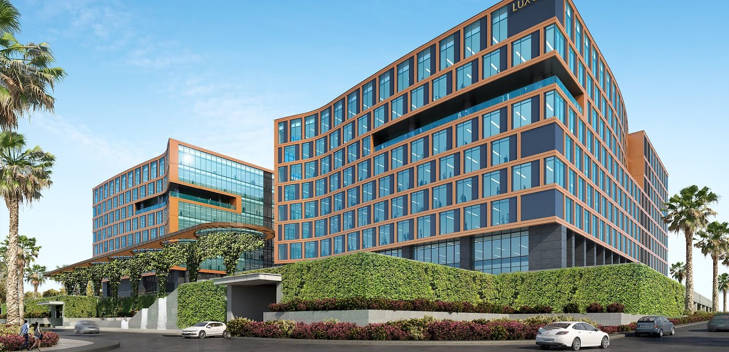
Microsoft Luxar

Slide 11
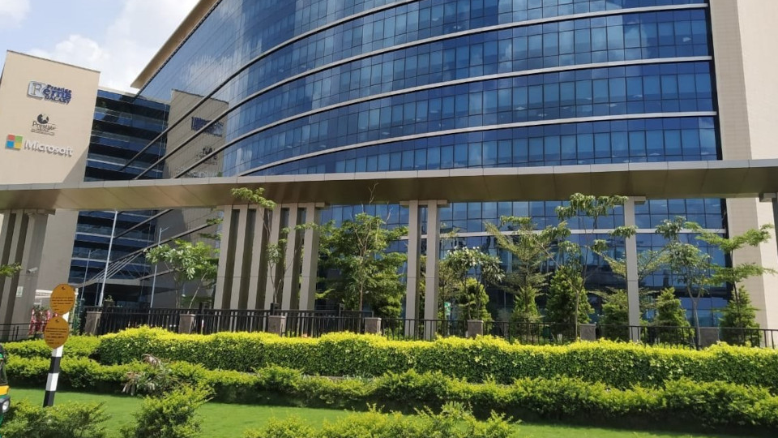
Microsoft Helium & Angkor

Slide 12
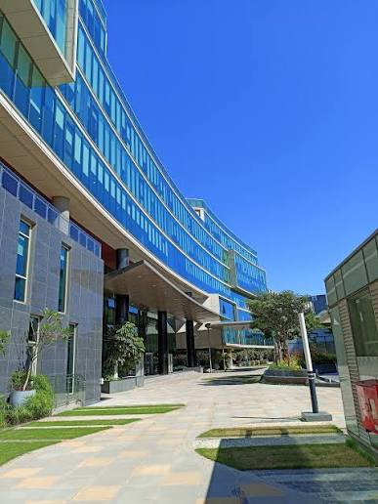
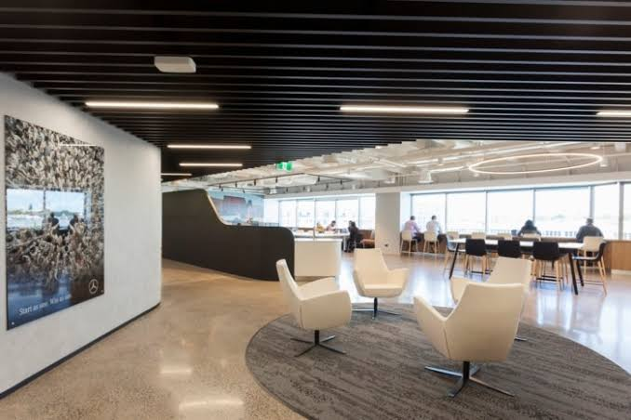
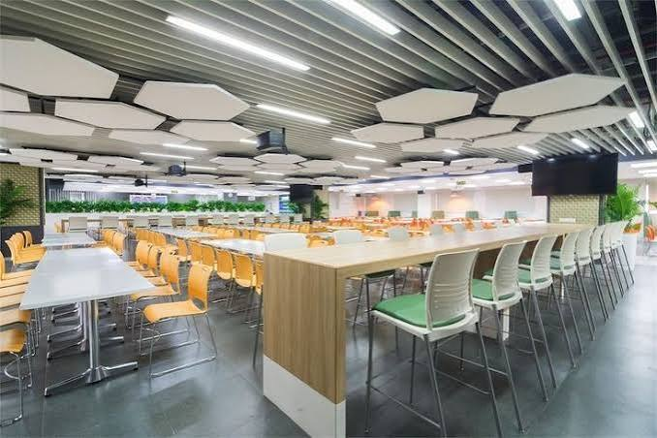
Mercedes Benz

Slide 13
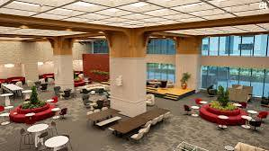
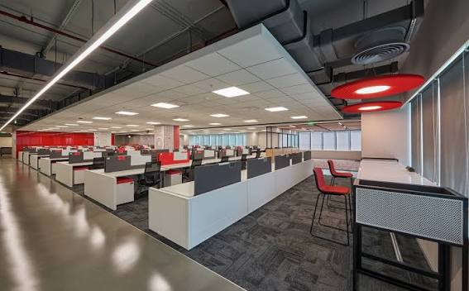
Target

Slide 14
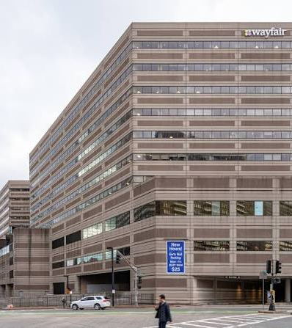

Wayfair Angkor

